Slide 1





Interaction Design Foundation
TEJAS PATEL - Z5454574
Notes:
Welcome back everyone to my presentation on the Interaction Design Foundation Assessment 3

Slide 2




Defining scope, aim and objectives
PROBLEM SPACE
How might we design a juicing experience that is engaging and fun for children, in order to increase their consumption of healthy fruit juice?
AIM
To design a juice-making experience that appeals to and engages children, encouraging them to consume more juice in a healthy and enjoyable way.
Objectives
To make them feel involved in the process.
To make the experience appealing to kids.
Notes:
My aim was to design a juice-making experience that appeals to and engages children, encouraging them to consume more juice in a healthy and enjoyable way. Our secondary objective is to make them feel involved in the process and make it appealing to them.

Slide 3

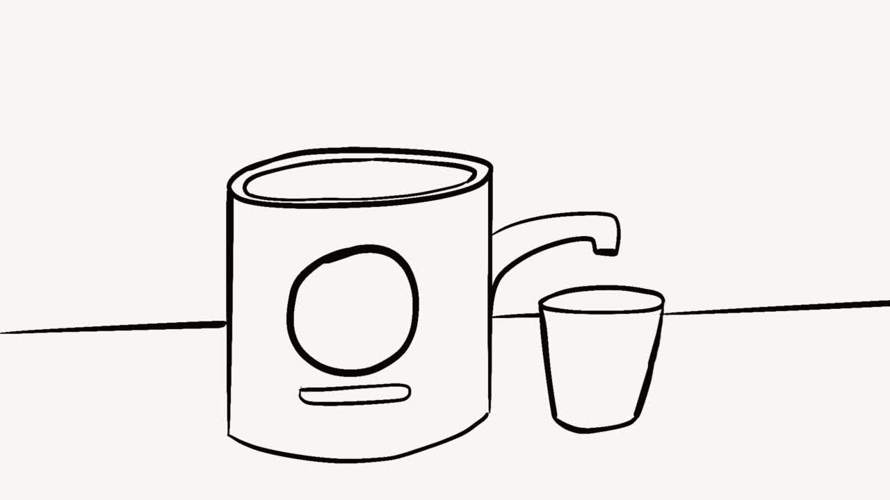
Play me!
Selected Concept
Moody juicer
Notes:
Today, I will be presenting my concept of a moody juicer that has moods similar to humans.

Slide 4

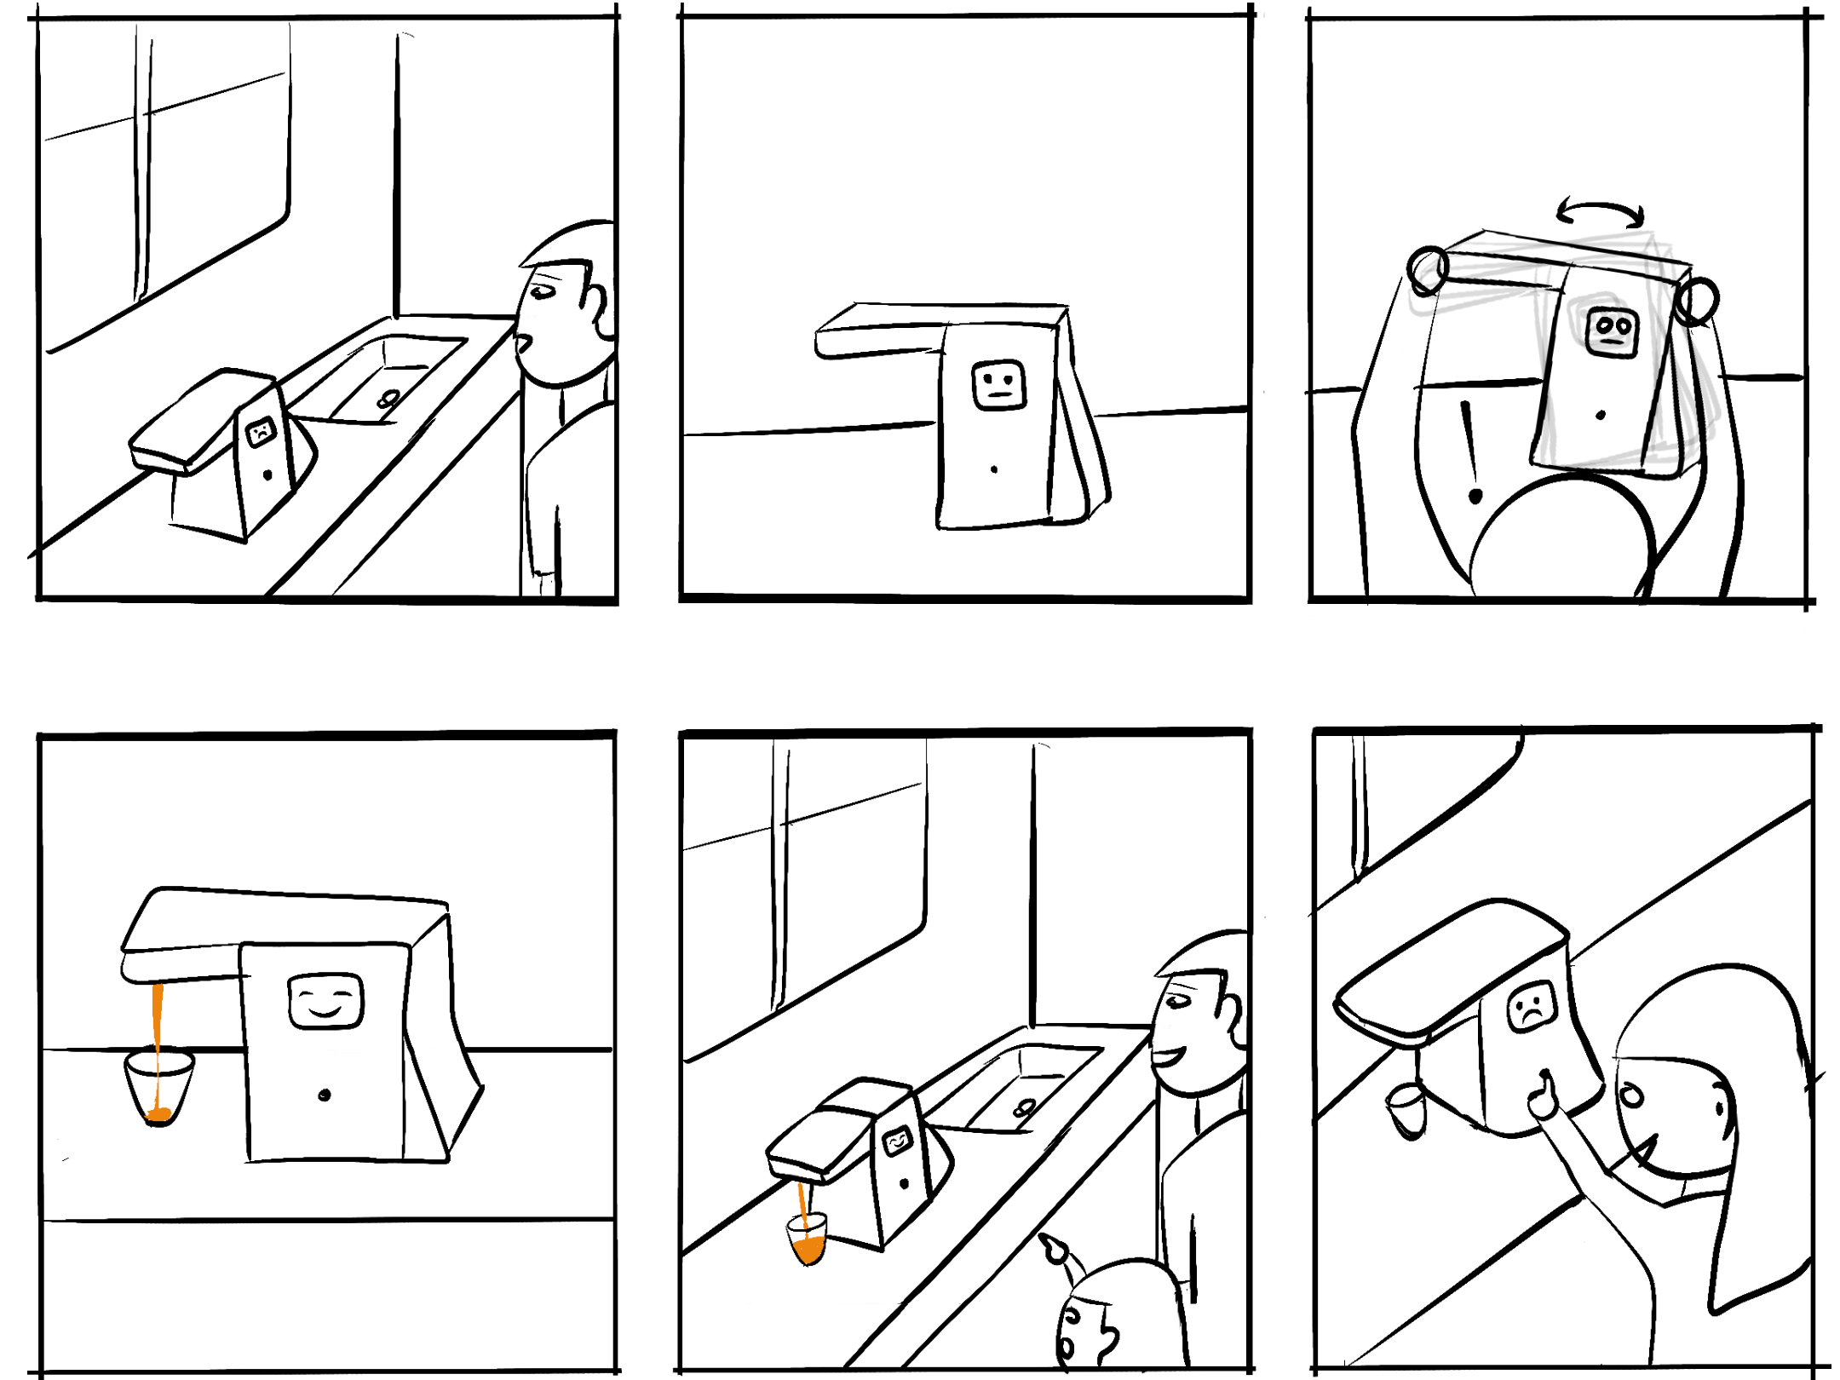

Jay turns to leave the kitchen and spots an interactive juicer with a moody face on the counter.
The juicer is in a "lazy" mood and does not want to make juice.
Jay remembers the instructions and gently shakes the juicer to wake it up and make it more active.
Scenarios/Story Board
Feeling energetic from all the shaking juicer now happliy makes juice
Meanwhile his kid is watching all this and now wants to play with juicer herself.
But now juicer is “sad” because it must make juice again. What will she have to do to get it to juice?
Notes:
i have created a scenario and storyboard that shows how a user interacts with the moody juicer. As the user prepares the fruits for juicing, the juicer's mood changes from lazy to happy to surprised.

Slide 5
Scope – Setting constraints
Project Scope
  The goal of this project is to design and develop an interactive juicer that appeals to parents who want their kids to drink more juice. The juicer will feature different moods such as happy, sad, lazy, and surprised, and will use various forms of interaction to engage users in the juice-making process. The project will include the following key features:
    Display to show system status.
    Different moods to match between system and real world.
    Indications for user to know what to do when juicer is in some mood.
Design Heuristics to be followed
  Visibility of system status
  Match between system and real world
  Recognition rather than recall
Notes:
Now, let's discuss the scope and constraints of the project. The goal of this project is to design and develop an interactive juicer that appeals to parents who want their kids to drink more juice. The juicer will feature different moods such as happy, sad, lazy, and surprised, and will use various forms of interaction to engage users in the juice-making process. The project will include key features like a display to show system status, different moods to match between the system and real world, and indications for users to know what to do when the juicer is in a specific mood. I will follow design heuristics like visibility of system status, match between system and real world, and recognition rather than recall.

Slide 6
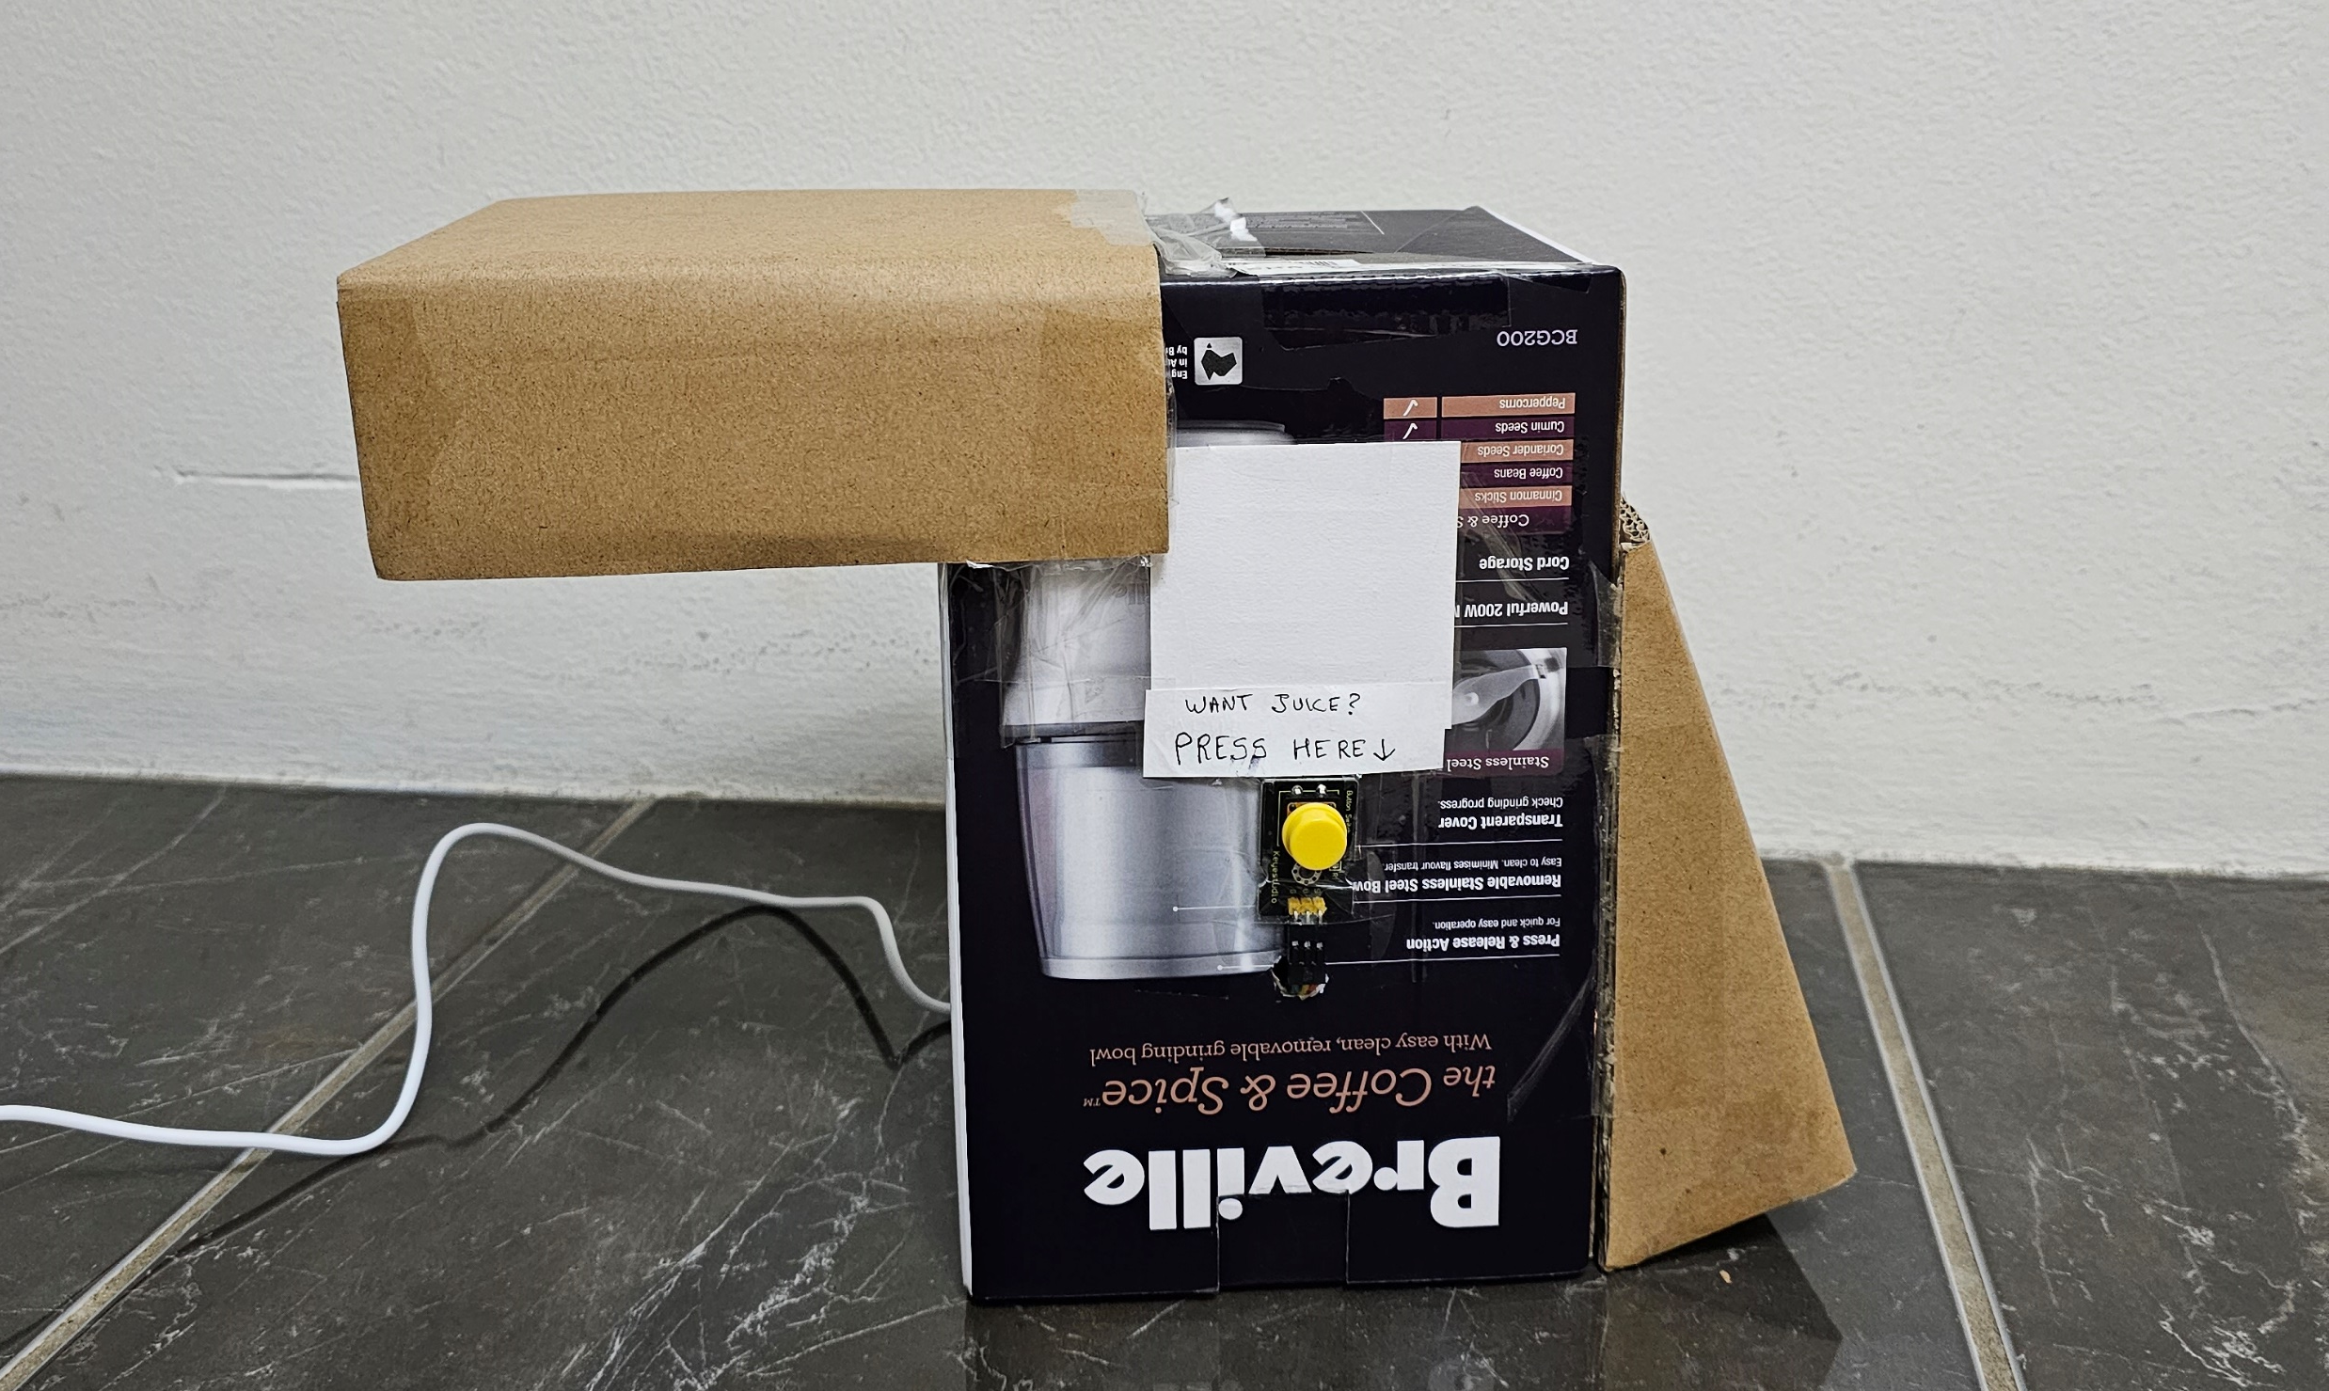
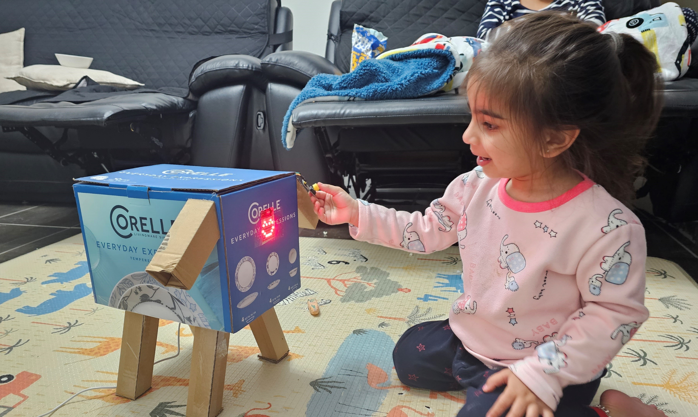
Milestone 1
Improve form of juicer
Notes:
Strengths of initial prototype
Form change, association with animal

Slide 7


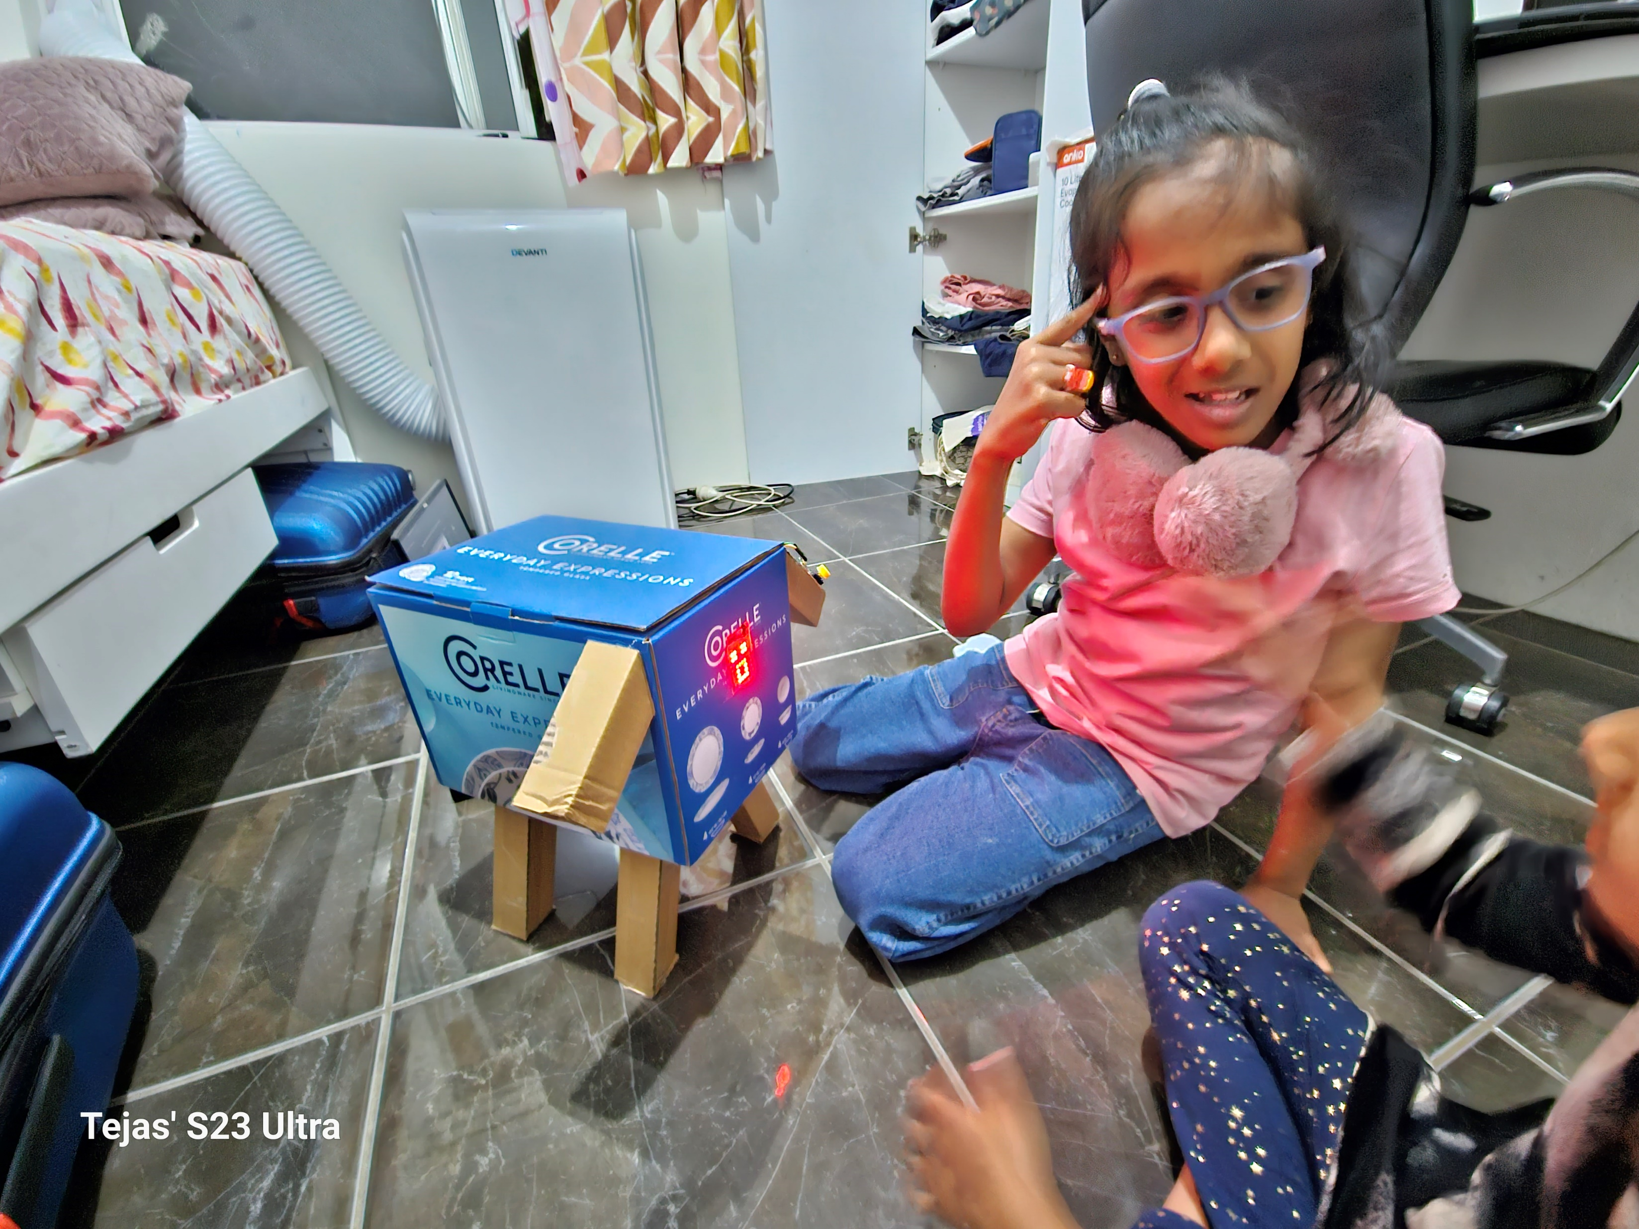
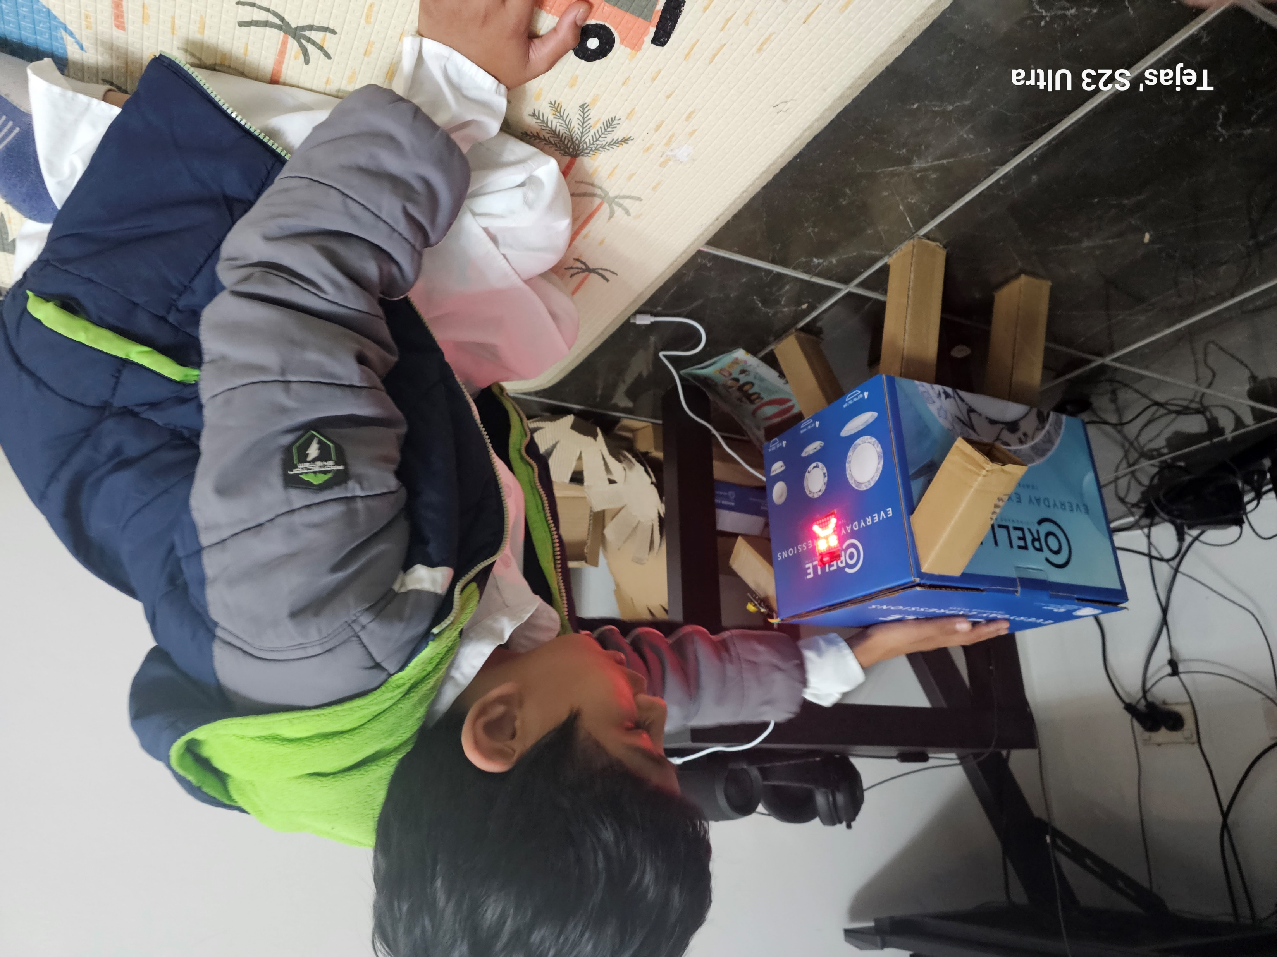
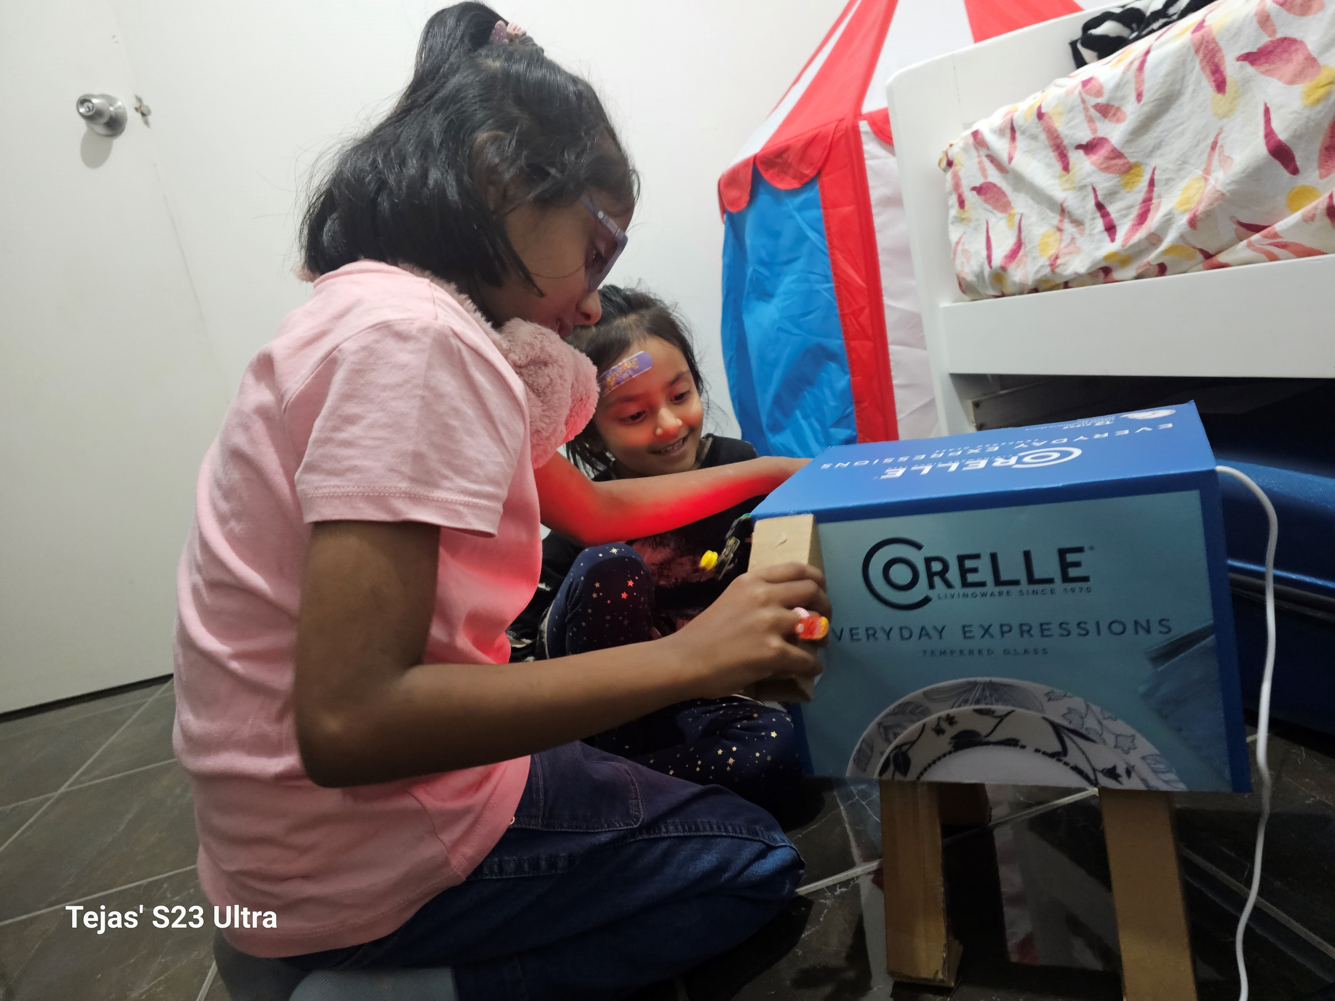

User Testing
Notes:
Valuable insights gained from user testing
Identified gaps between conceptual model and users' conceptual model
Adults focused on consistency between moods, while children found surprised mood boring
Users needed more guidance on how to interact with the juicer
Changes made to form, adding signifiers and progress bar for clarity
Changed number of triggers required to make the juicer happy
Changed tone and eye animations to indicate directionality of interaction
Changed interaction with surprised mood to hungry mood where users must feed the juicer

Slide 8
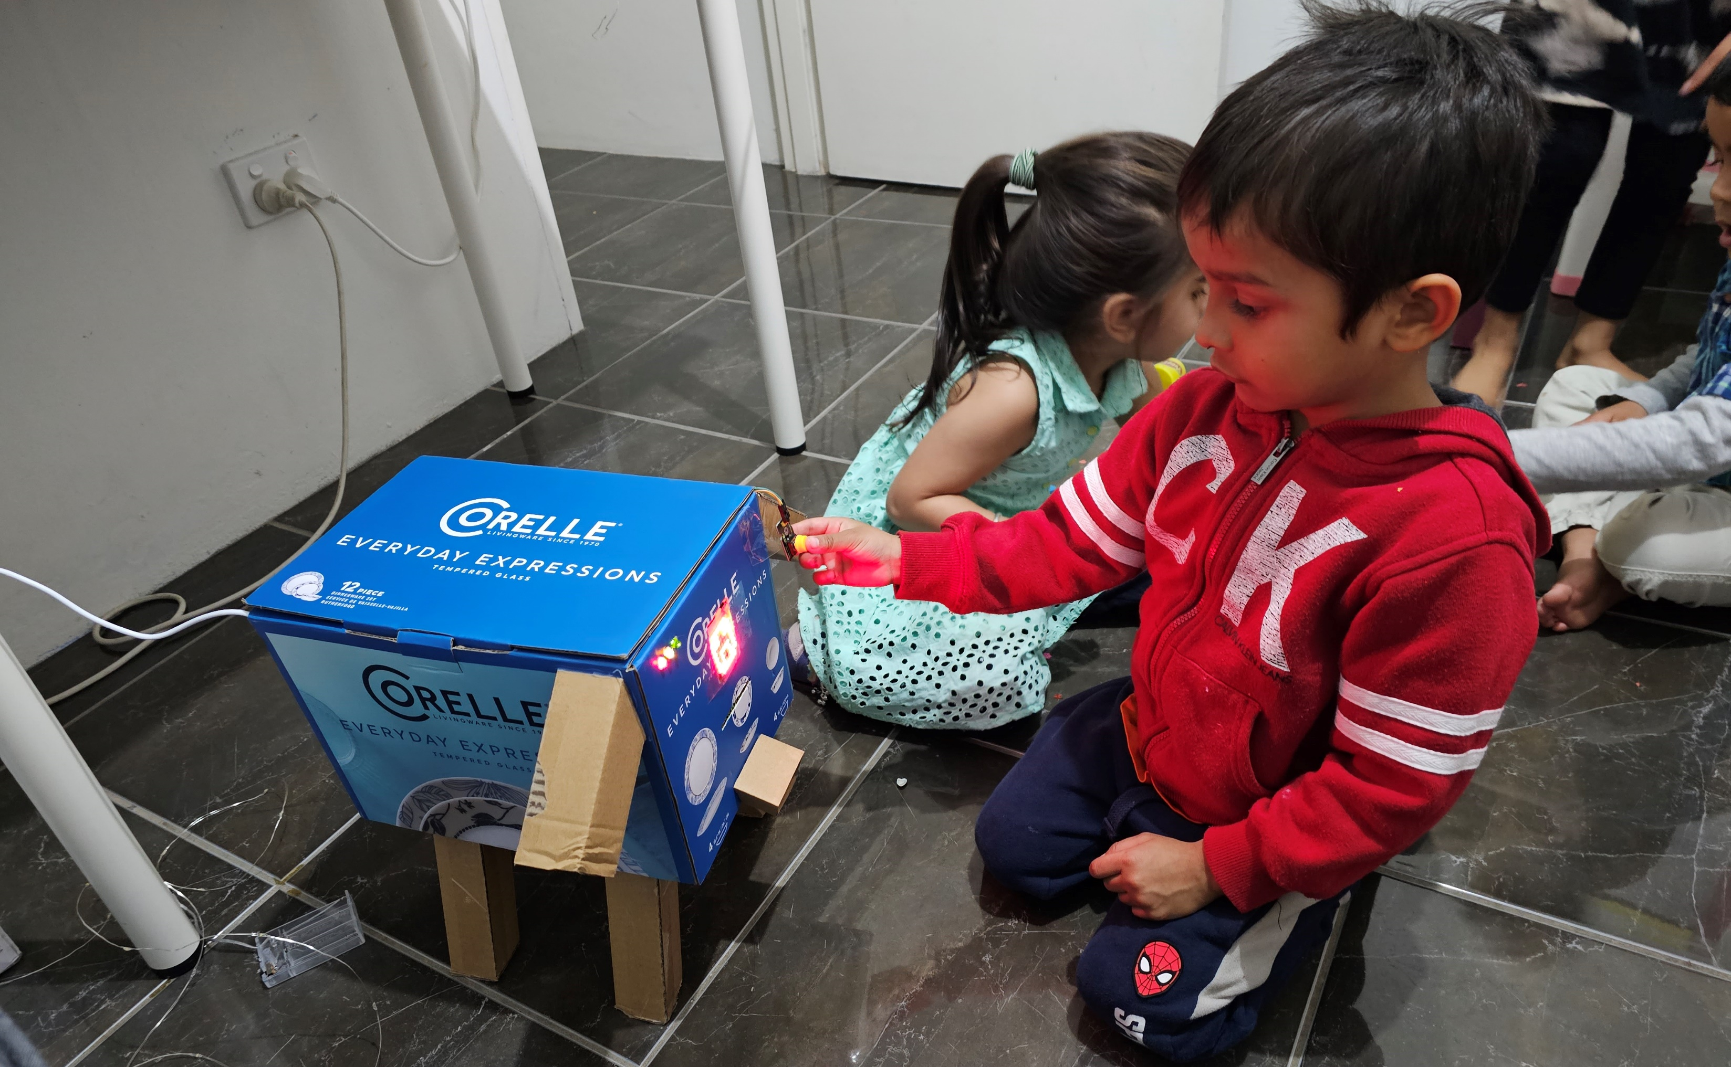
Milestone 2
Improving interactions
Notes:
Sound, animation, progress bar, led

Slide 9
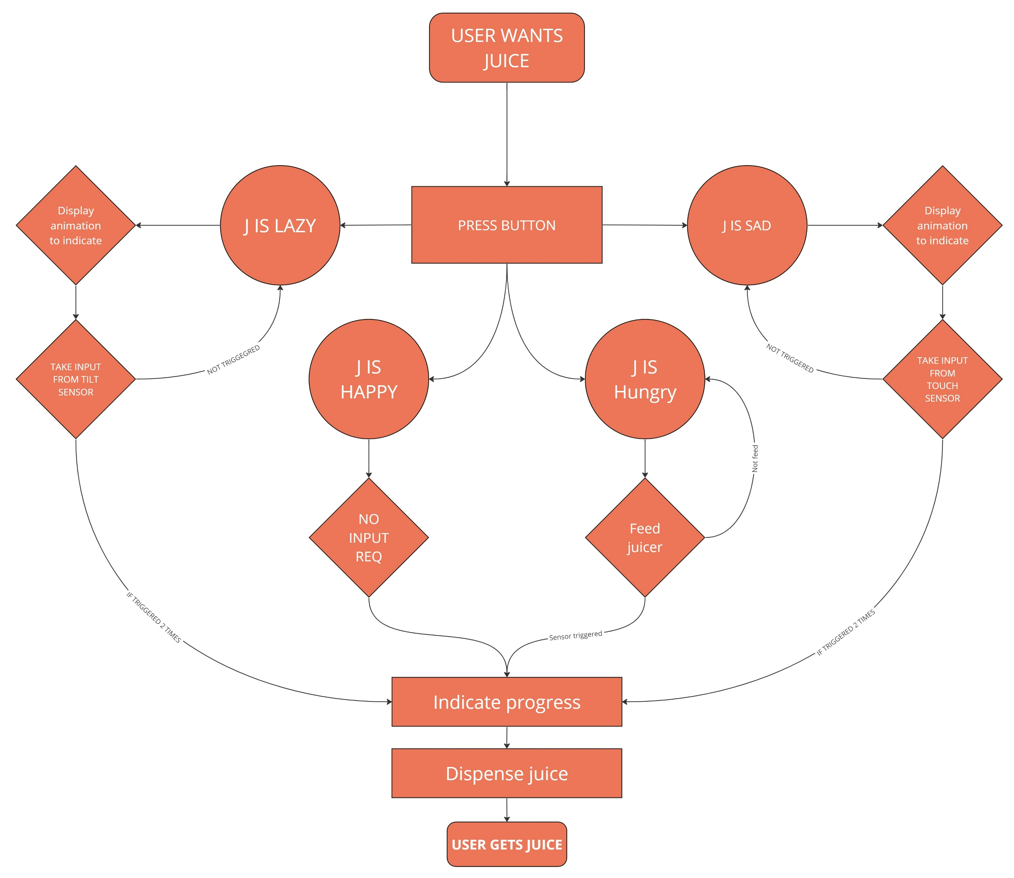
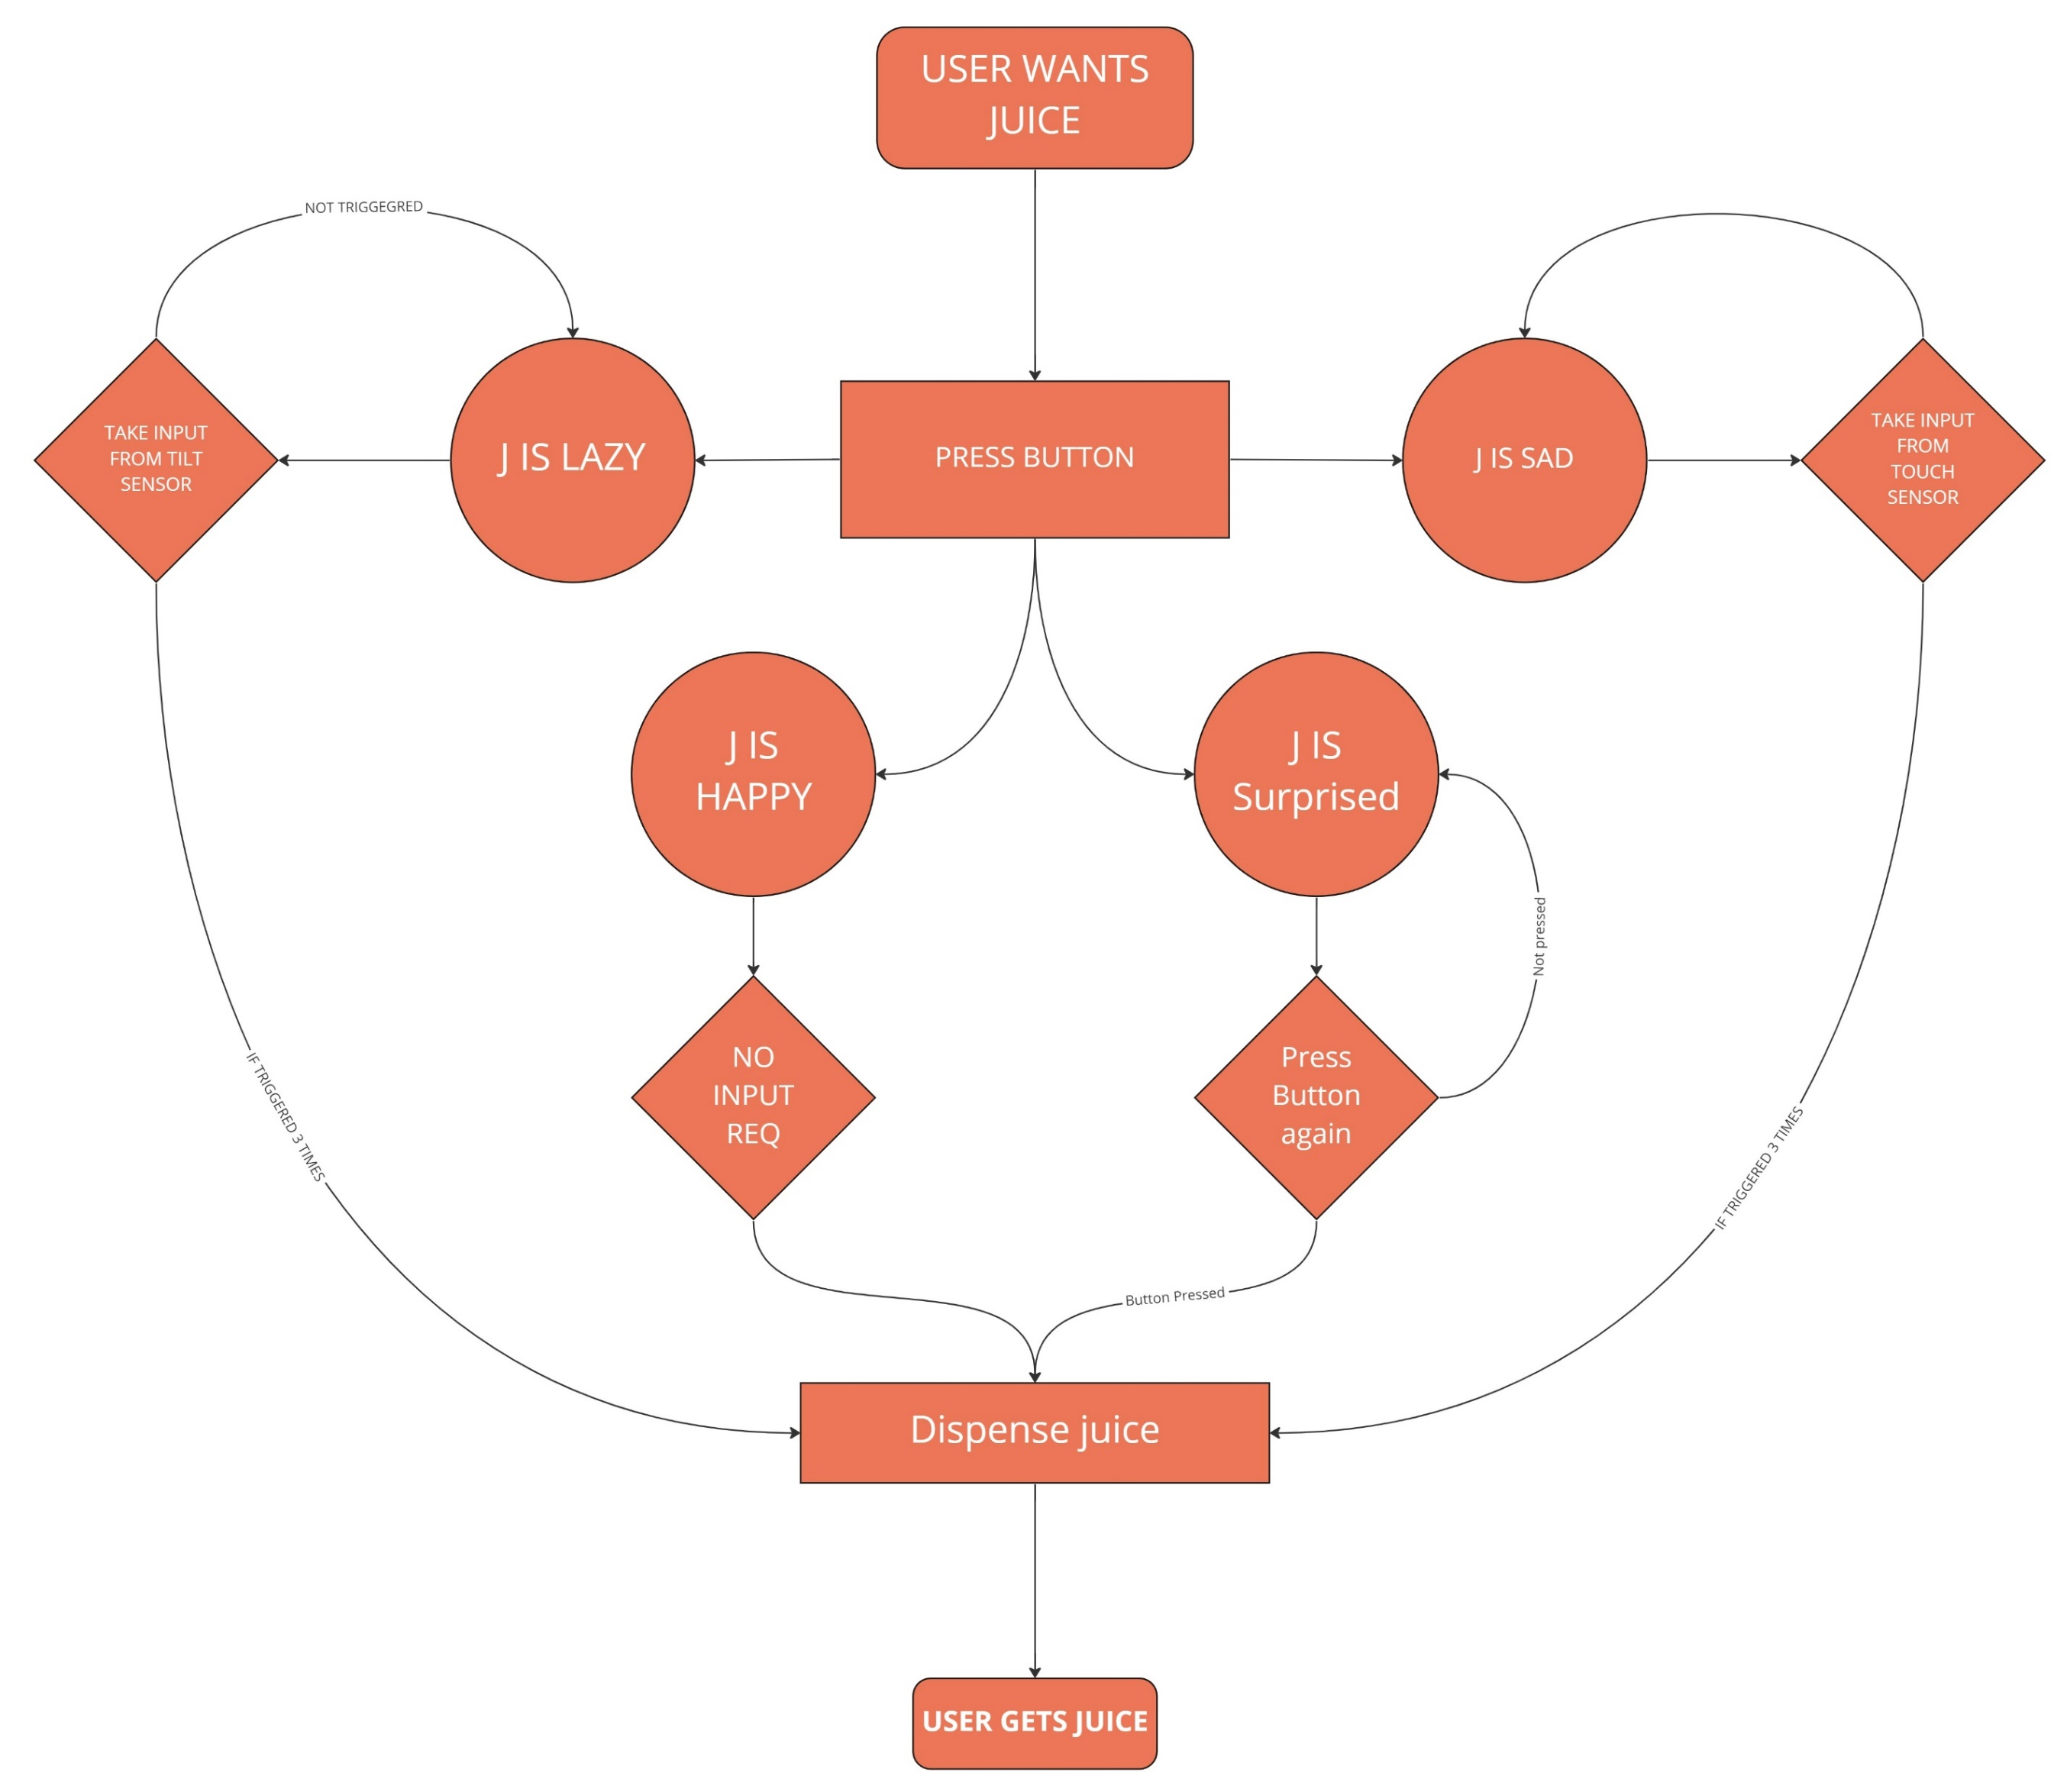
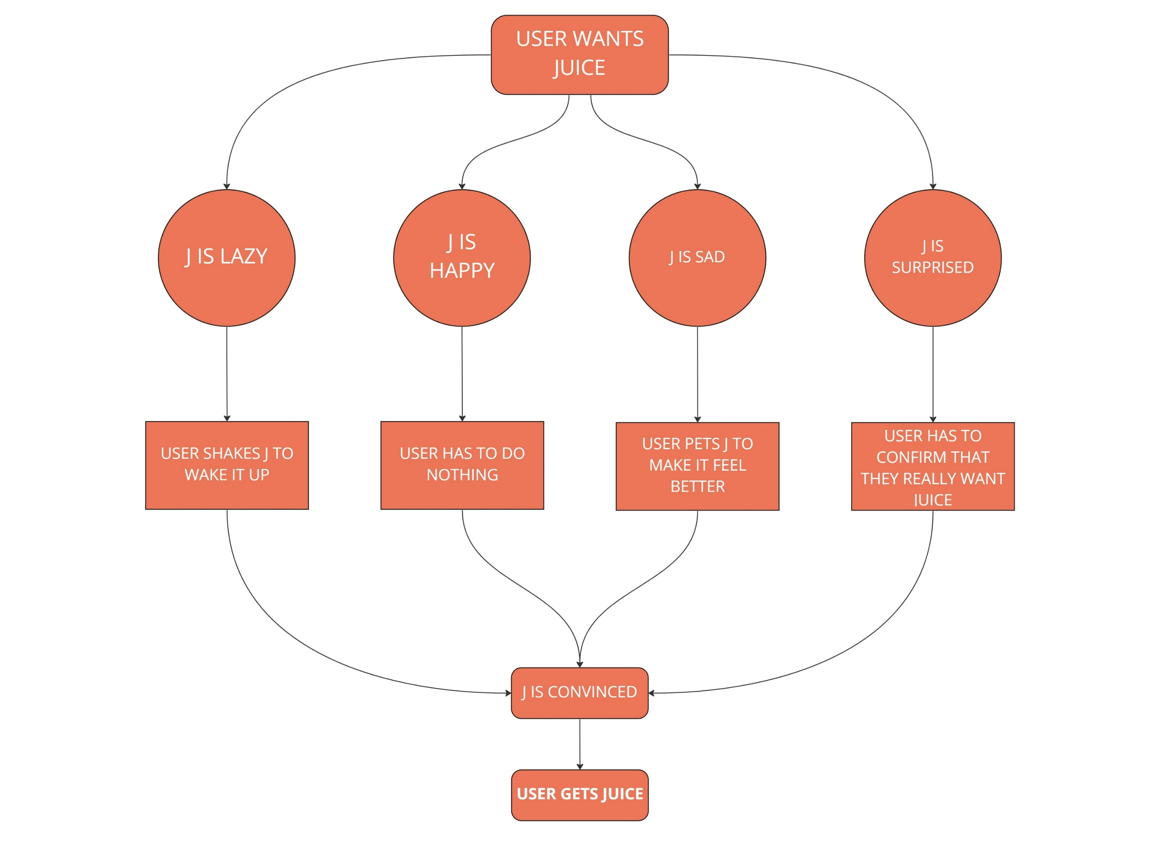
Conceptual Model
Notes:
I have created a conceptual model of the moody juicer featuring four moods: happy, sad, lazy, and surprised. In the happy mood, the user doesn't need to do anything, and the juicer makes juice right away. In the sad mood, the user has to pet it to get it to make juice. In the lazy mood, the user has to shake the juicer to get it to make juice, and in the surprised mood, the user has to press a button to confirm.

Slide 10
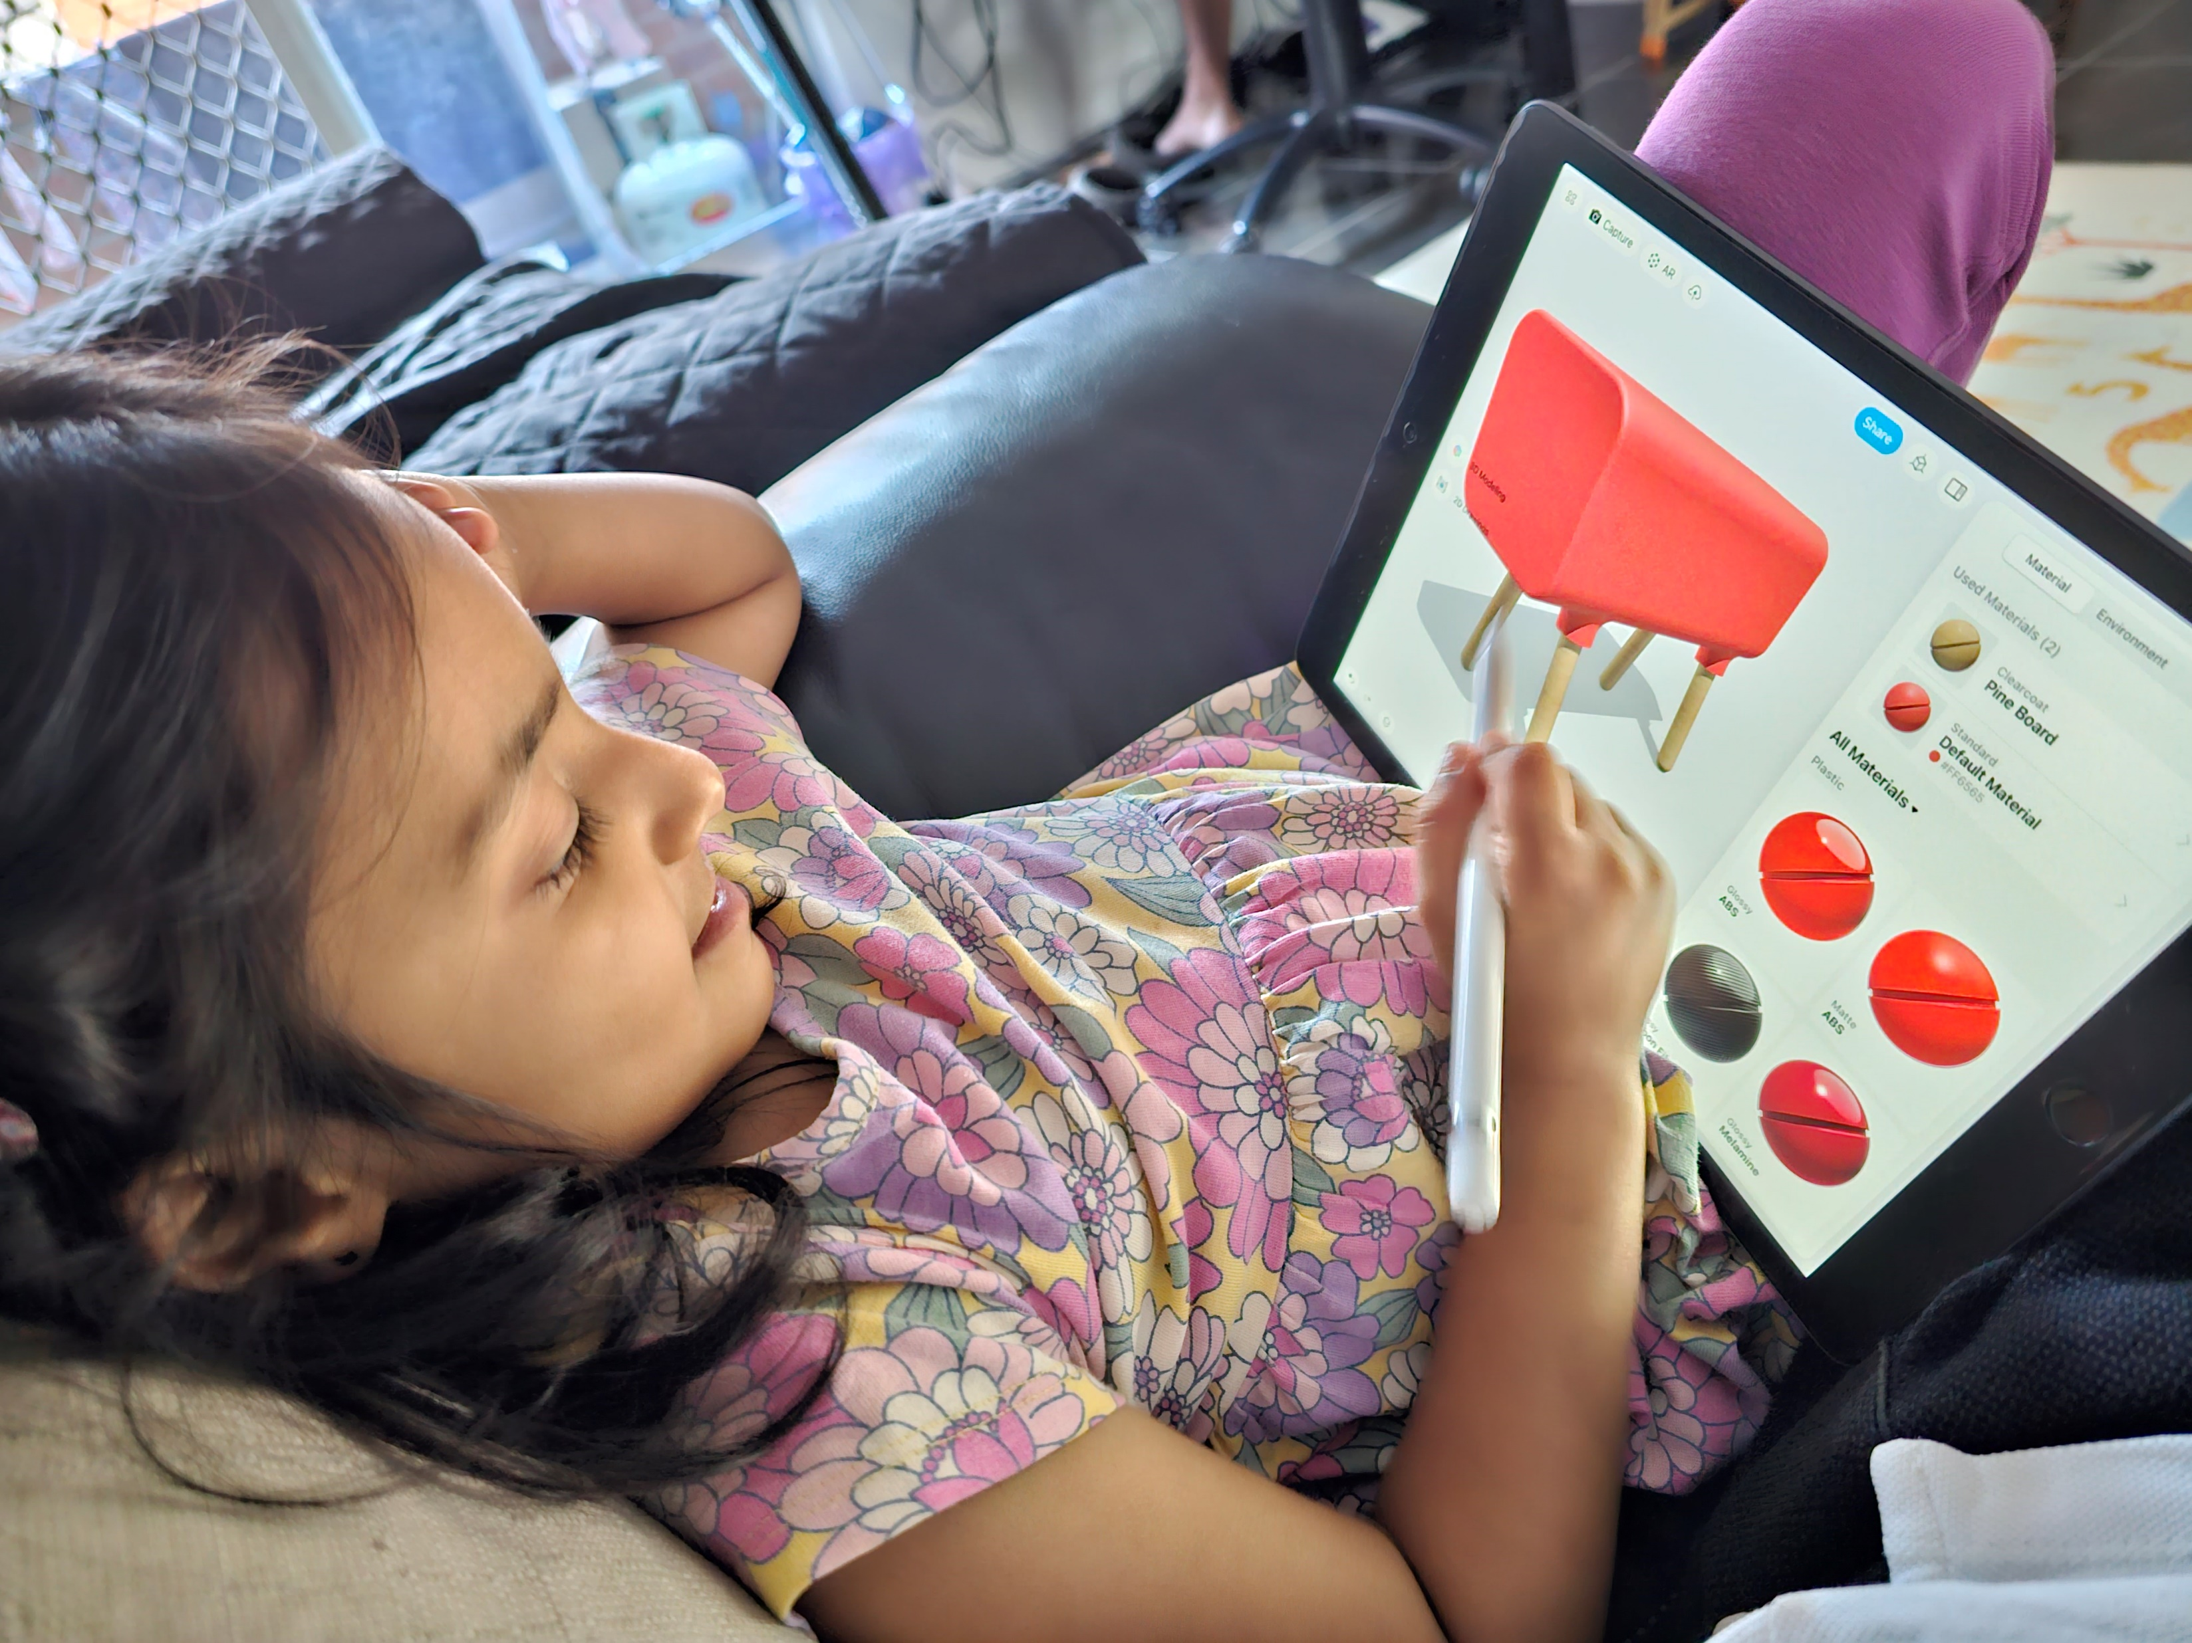
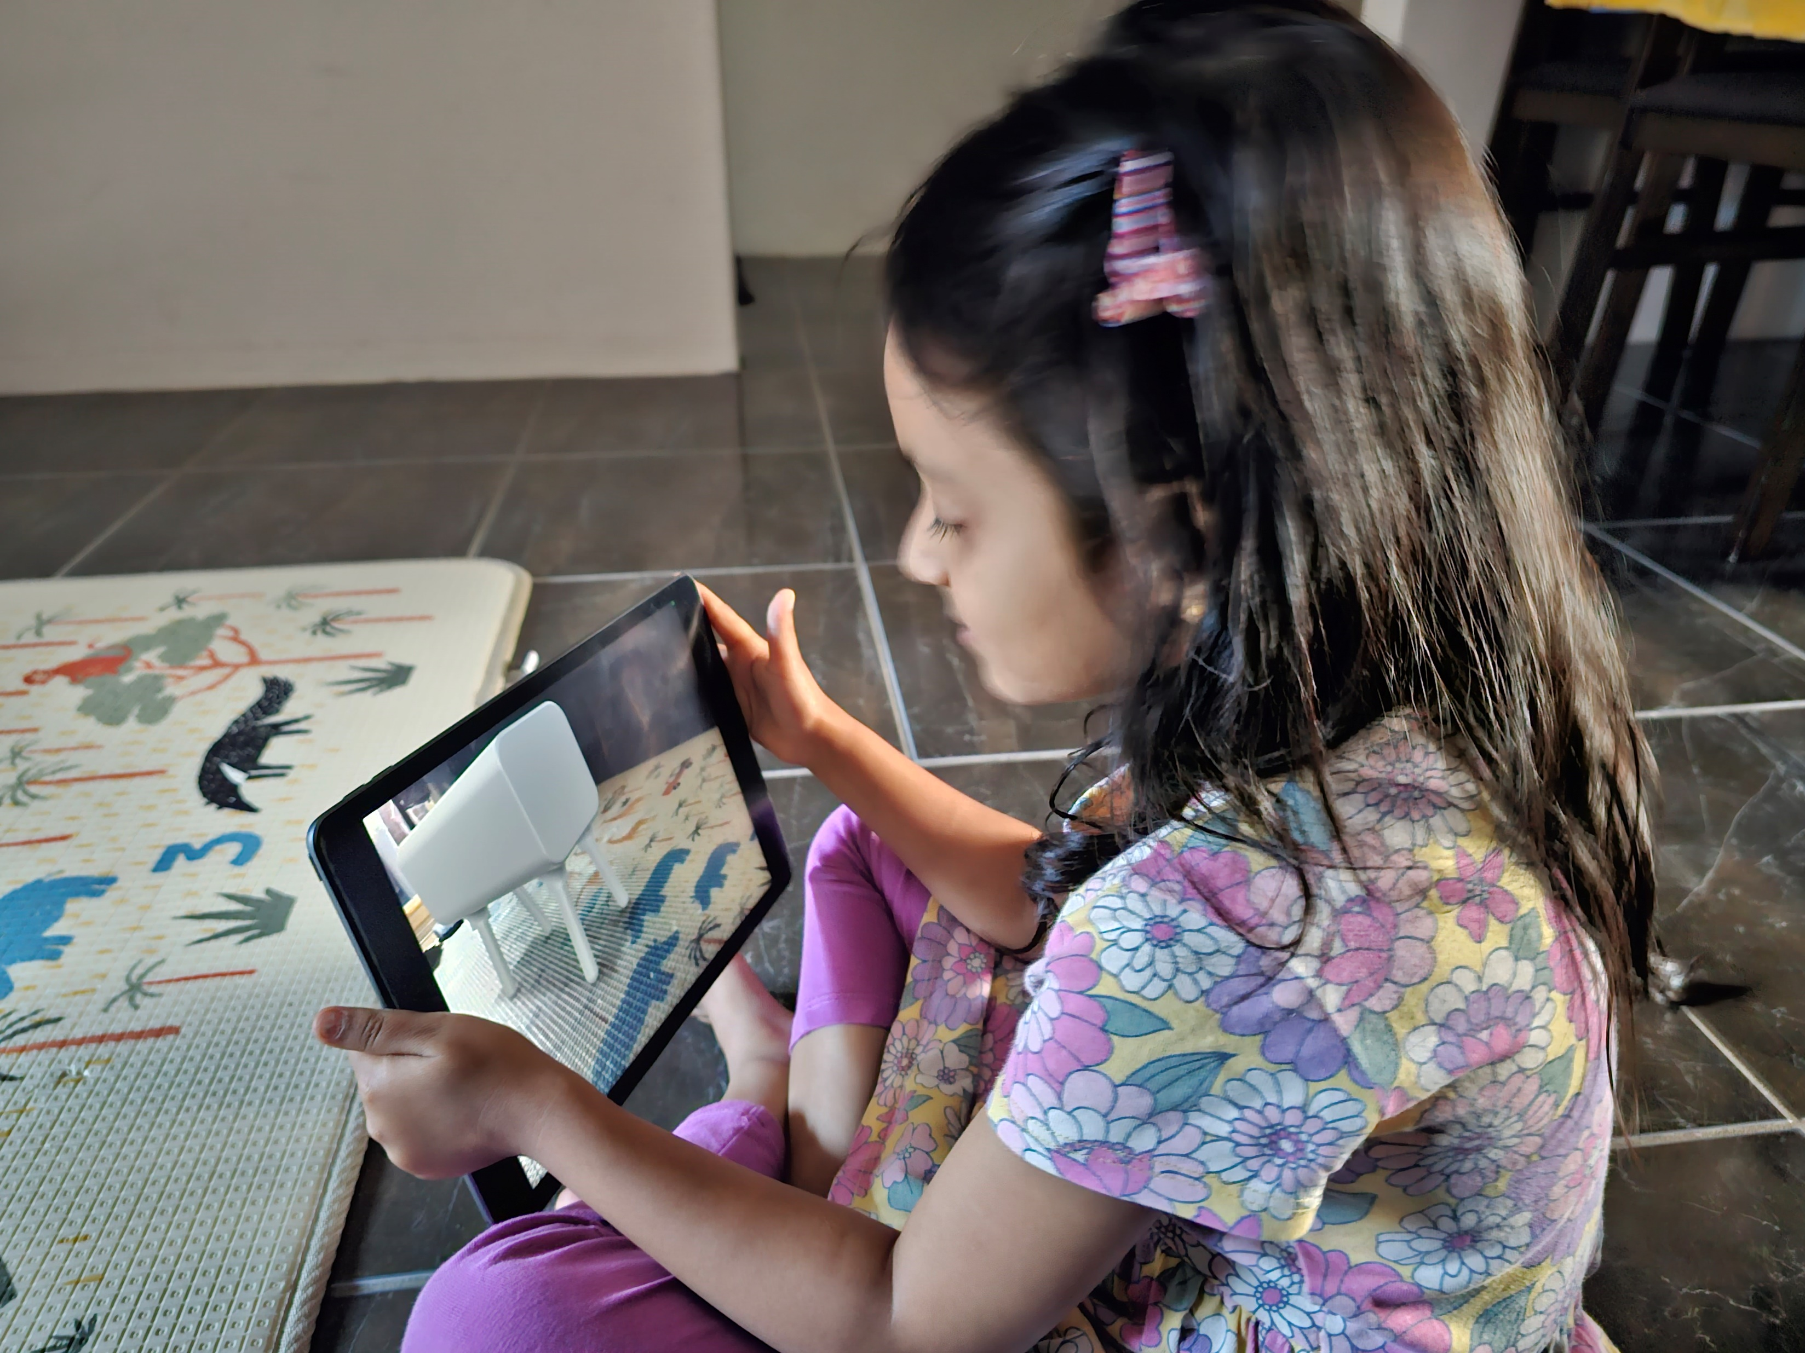
Future works
Moody juicer
Notes:
Used augmented reality with kids for feedback on form and colors
Next step is to go towards figuring out mechanism that would it in this form
Using participatory design to advance and refine this prototype
Finding a better way to display faces as dot matrix is limiting at this point

Slide 11
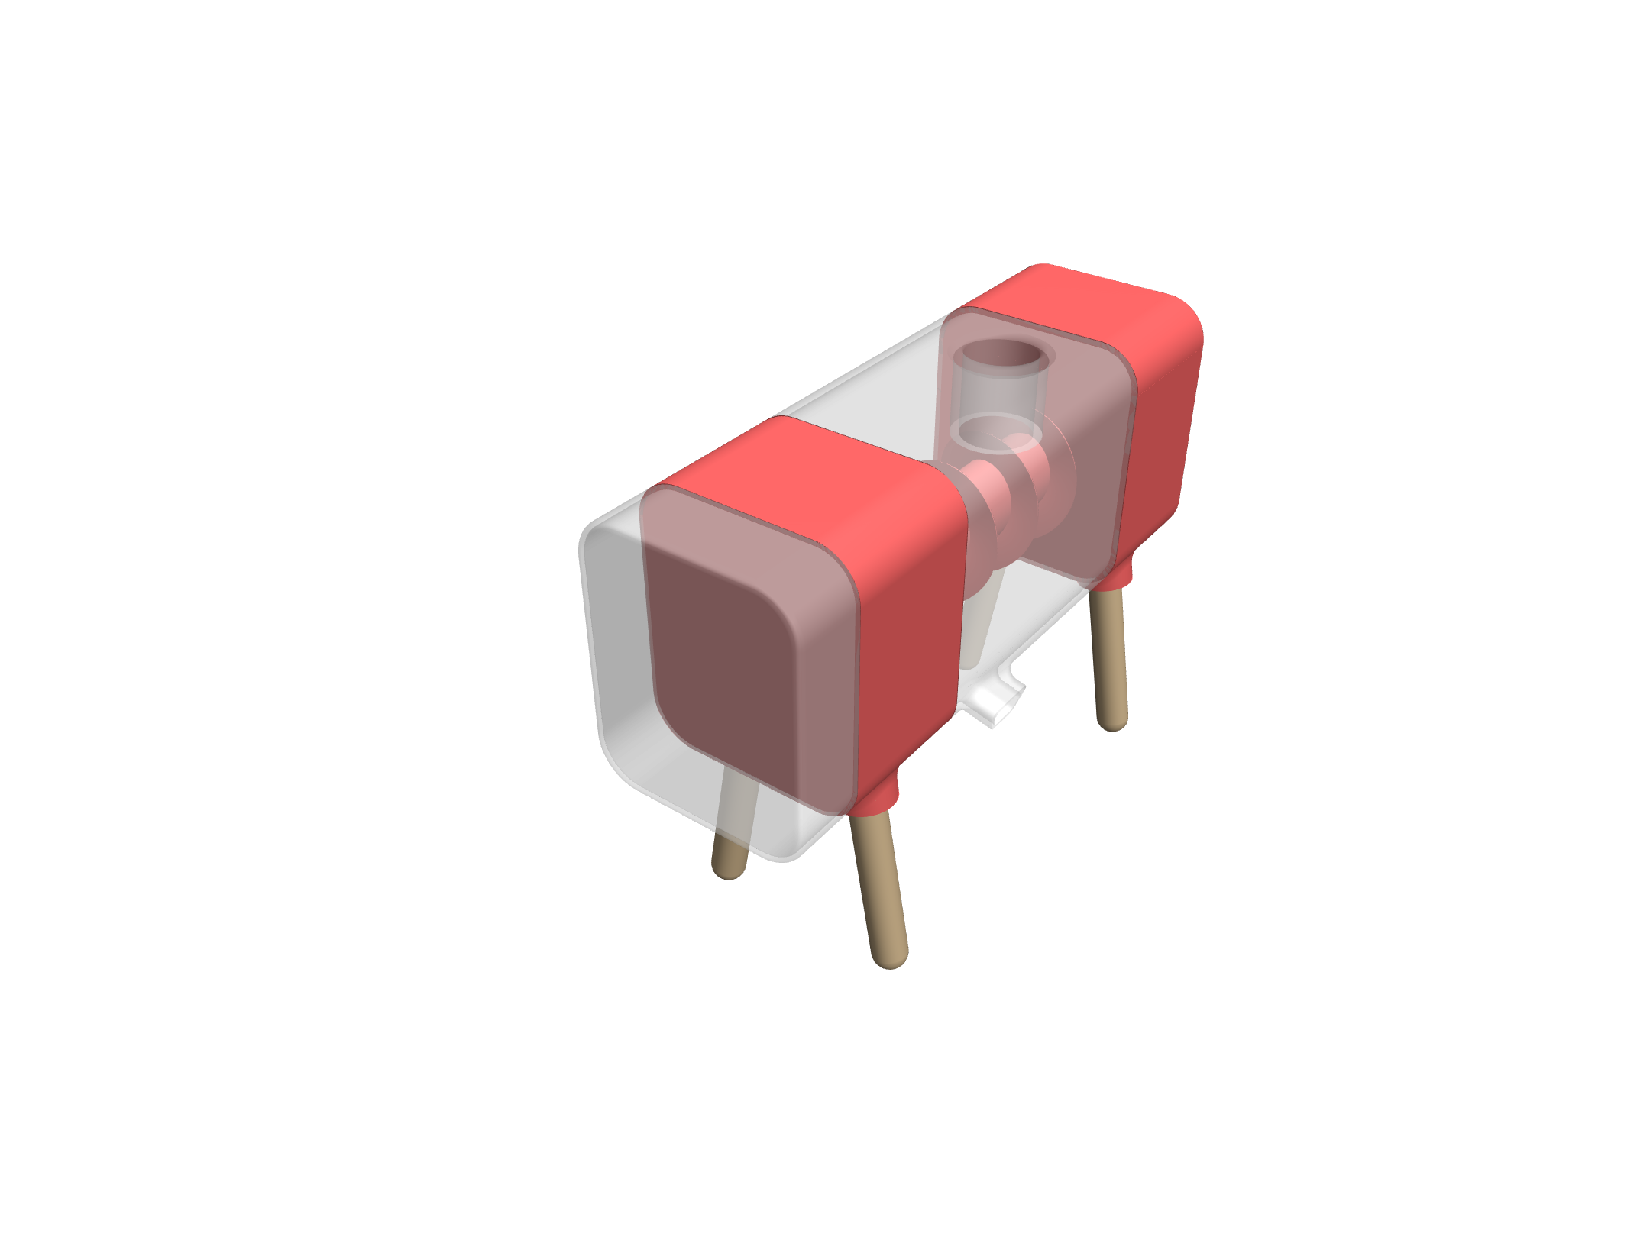
Future works
Moody juicer

Slide 12

Thank You
"Get your daily dose of mood-boosting juice!"

